Slide 1
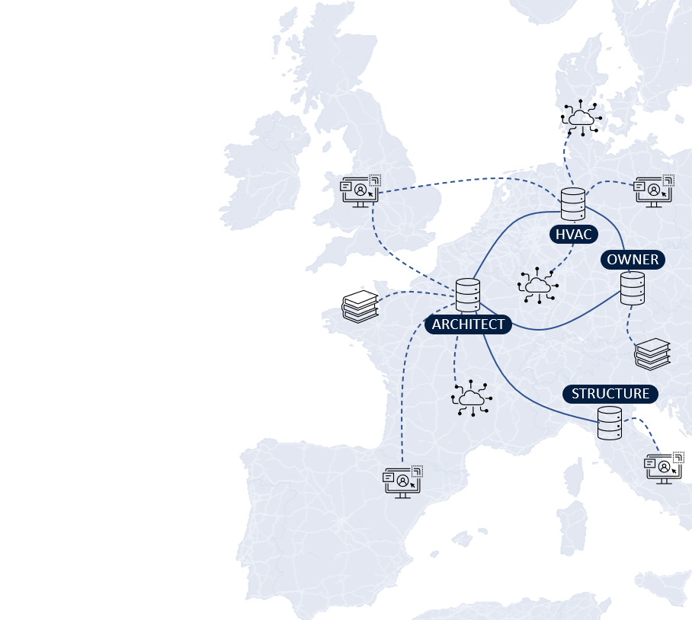
LBDserver A Federated Ecosystem for Heterogeneous Building Data
Jeroen Werbrouck – Pieter Pauwels – Jakob Beetz – Erik Mannens
LBD Community Group presentation – 14/12/2021

Slide 2
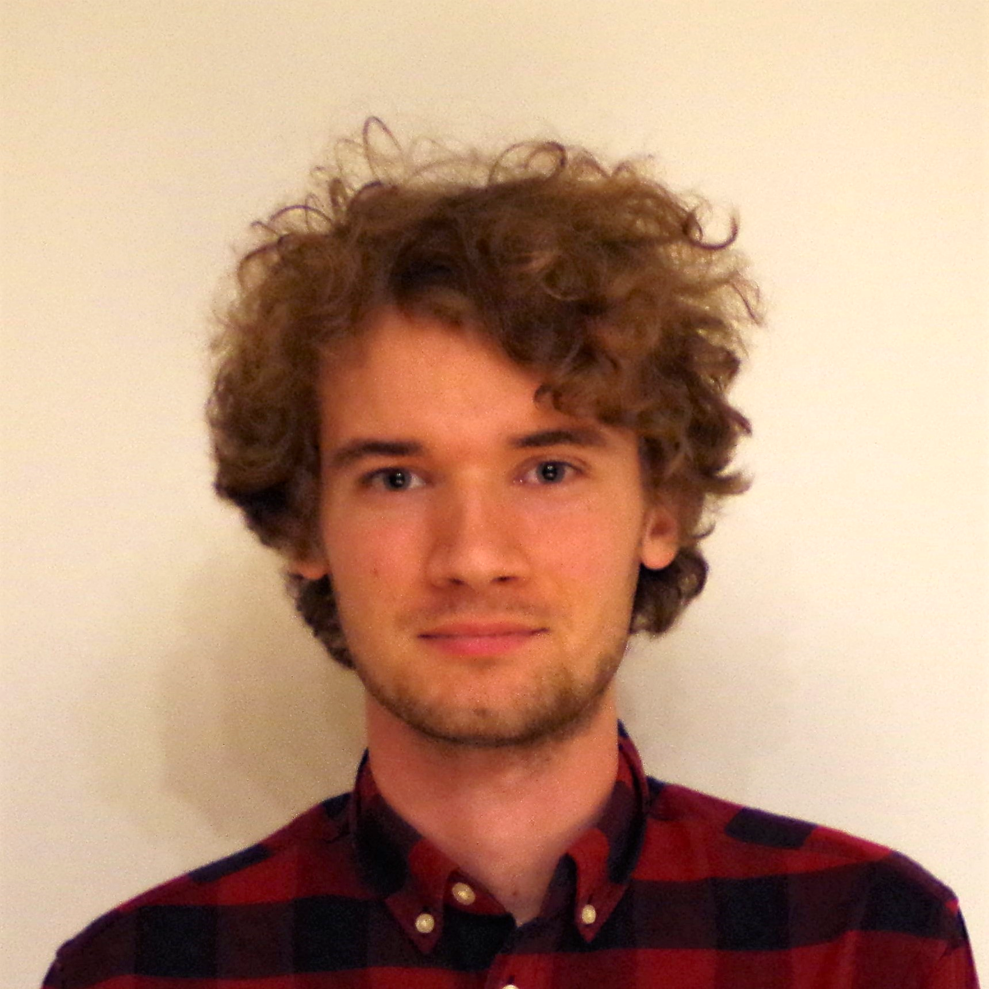
Project background
PhD research grant FWO Flanders (2019-2023)
Web- and data-based AECO projects
Data federation
Semantic data models (RDF) & sub-document identifiers (no RDF)
Modular, “plugin-based” service infrastructure

Slide 3
introduction

Slide 4
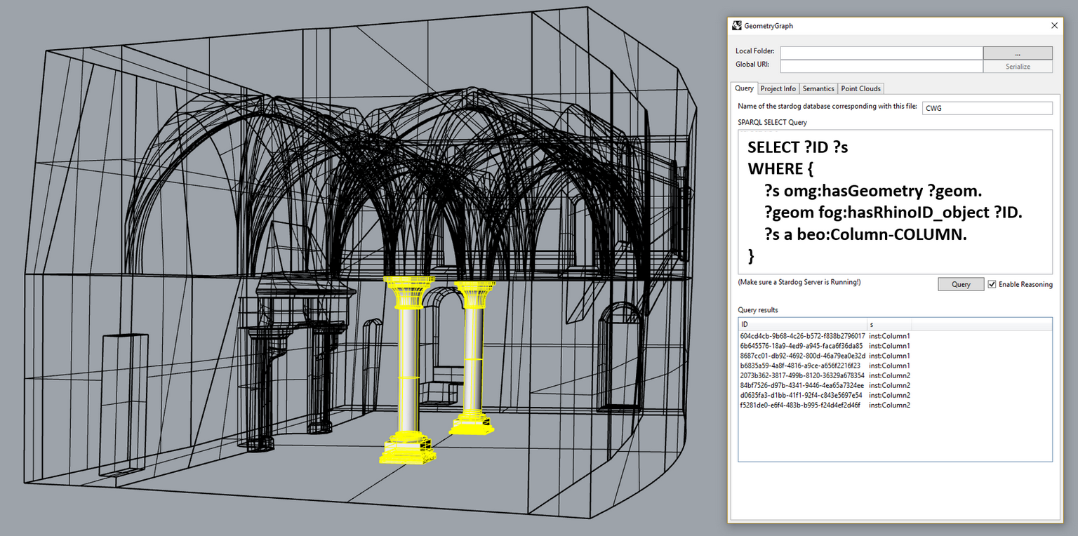
semantic enrichment of heterogeneous data
Scan-to-Graph semantic enrichment of existing building geometry (LBD CG 01/12/2020)
BUT: limited scope
Central data storage (triple store)
Use geometry to access/enrich semantics
EXTENSION:
Federated data storage
Use any resource to access any other resource in the project
https://doi.org/10.1016/j.autcon.2020.103286

Slide 5
Context: Data Federation in AEC
Project-specific data
Contextual data
Services
Data heterogeneity
Decentralised access control
Sub-document information linking
“Using a 3rd party Web BIM service, the Asset Owner localises a damage pattern on a picture of the Facility Manager, linking it to an existing building element via the as-built 3D model provided by the Architect, and referring to external regulation datasets provided by the government.”

Slide 6

Presentation overview
HVAC eng.
Architect
FM
Struc. eng.
1. Project Discovery and storage patterns

Slide 7

Presentation overview
HVAC eng.
Architect
FM
Struc. eng.
2. Federated sub-document linking

Slide 8
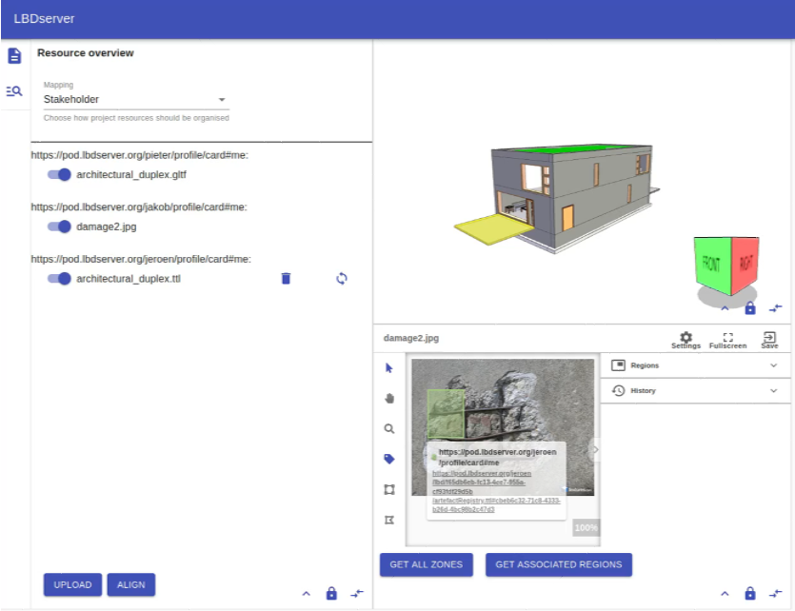

Presentation overview
HVAC eng.
Architect
FM
Struc. eng.
3. Concepts for flexible end-user interaction

Slide 9
1. Data patterns

Slide 10
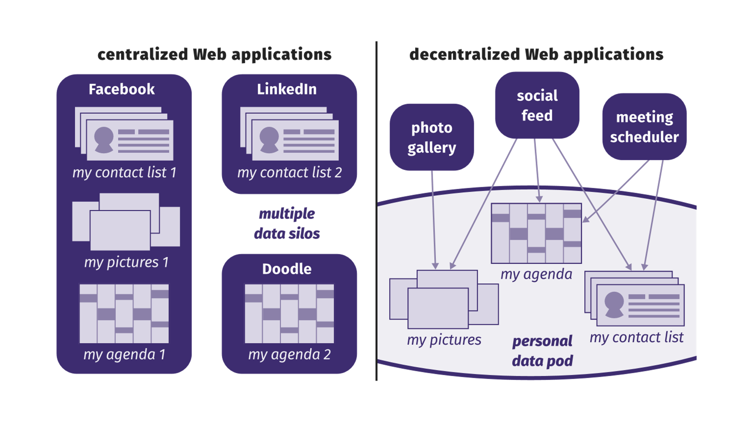
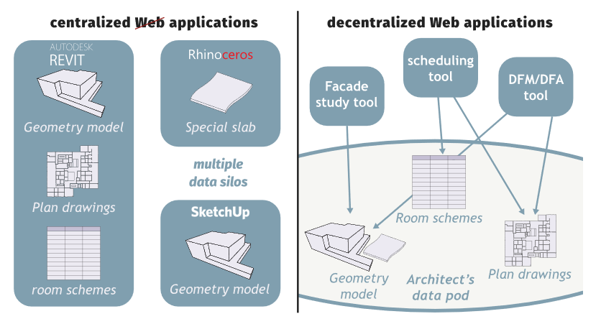
Context: Solid
Web ID: A URL that represents an actor on the Web “Web username”
Data Pod: Personal data storage linked to a Web ID Linked Data Platform (LDP) + AUTH
Identity Provider: Instance hosting your WebID (and Pod) Can be self-hosted
© Ruben Verborgh, 2018
© Mads Holten Rasmussen, 2018
DATA PATTERNS
Notes:
Data wiring: RDF
Data content: heterogeneous

Slide 11
Needs
Discovery of project data
Via stakeholder WebIDs (e.g.: <https://pod.arch-office.org/profile/card#me>)
Via project access points / aggregators
Aggregation of access points: combine projects by topic/typology/consortium/…
Integration of traceable heterogeneous sources & (internal/external) data distributions
Persistent storage (topic-independent organisation)
Registration of sub-document references to project resources & alignment of local references
DATA PATTERNS

Slide 12
Project discovery
{hvac}/profile/card#me
{arch}/profile/card#me
lbd:hasProjectRegistry
/lbd/(.meta)
/lbd/(.meta)
The project registry of a stakeholder is no more than a specific “aggregator”; an LBD container which groups projects where this stakeholder participates in.
ldp:contains
/lbd/{ID}/(.meta*)
(ldp:contains)
/lbd/{ID}/(.meta*)
The project access point is an LDP container which effectively contains the contributions of the stakeholder (/local/), and virtually contains relevant contributions of other stakeholder in the project.
VIRTUAL
ldp:contains
/local/(.meta)
/local/(.meta)
* In Solid, “.meta” files are mapped to specific LDP containers. Dereferencing the container yields the .meta resource.
** By default, “.meta” files in Solid cannot be edited directly. In this case, this restriction was overruled in favor of project organisation
DATA PATTERNS

Slide 13
Project organisation
…
<> dct:creator <https://pod.arch-office.com/profile/card#me> ;
a lbd:PartialProject,
dcat:Catalog ;
lbd:satellite <https://satellite.arch-office.com/> .
/local/(.meta)
./references/(.meta)
lbd:datasetRegistry /
ldp:contains
./services/(.meta)
./rules/(.meta)
ldp:contains
ldp:contains
./datasets/(.meta)
ldp:contains
./dataset1/(.meta)
./dataset2/(.meta)
./dataset3/(.meta)
ldp:contains
./distribution1
DATA PATTERNS

Slide 14
datasets
…
./dataset1/(.meta)
<> a dcat:Dataset ;
dct:title “the title of the dataset”;
dcat:keyword “topology” ;
dcat:distribution <distribution1> , <distribution2> .
<distribution1> a dcat:Distribution ;
dcat:downloadUrl </distribution1> .
<distribution2> a dcat:Distribution ;
dcat:accessService serv:service1 ;
dcat:accessURL <http://satellite.arch-office.com/sparql?dataset={URI-of-distribution-1}&query=> .
ldp:contains
./distribution1
!
May refer to Pod-external (contextual) datasets as well
SATELLITE?
DATA PATTERNS

Slide 15

satellites
Solid Pod is the main access point
Sometimes, external services are needed…
APIs / orchestration services:
CRUD project data
Maintain consistency
Provide virtual views on top of datasets
Querying (SPARQL service, time series)
Document store (MongoDB, …)
Require powerfull access control rights! (TRUST)
Pod-specific “Satellites” (one or more)
DATA PATTERNS

Slide 16
2. Sub-document linking

Slide 17
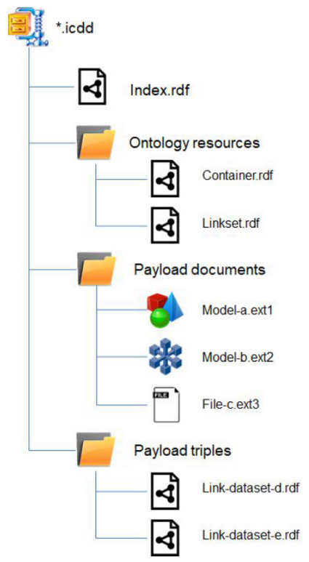
Context: sub-document linking - ICDD
Information Container for linked Document Delivery (ICDD, ISO 21597)
RDF vocabulary to semantically integrate non-RDF resources
ZIP container with dump of entire project
Final point of data exchange
Not a database
Not a CDE
© ISO 21597
SUB-DOCUMENT LINKING

Slide 18
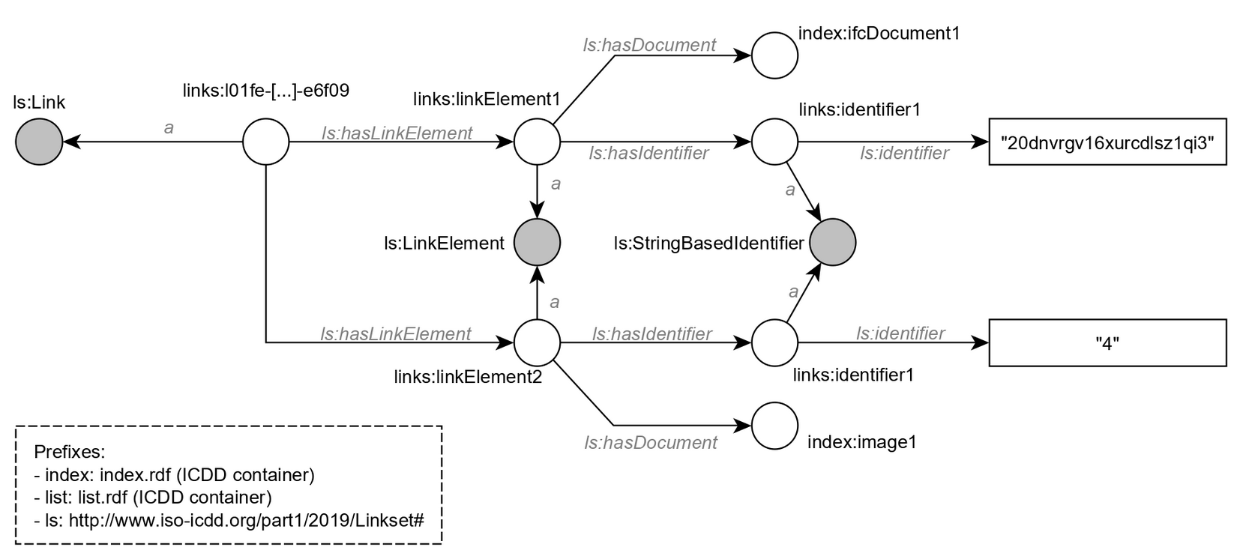
Context: sub-document linking - ICDD
Information Container for linked Document Delivery (ICDD, ISO 21597)
ZIP container with dump of entire project
RDF vocabulary to semantically integrate non-RDF resources
START HERE!
“20dnvrgv16xurcdlsz1qi3”
{“x”: 30, “y”: 15, “w”: 100, “d”: 80 }
SUB-DOCUMENT LINKING

Slide 19
Reference registry
Linking dataset-specific contexts to project-wide “abstract concepts”
Dataset Local project
Local project Global project
Enriching a concept “Door X has parameter P”
Enriching the representation of a concept “Geometry Y, which represents Door X, has an insufficient LOD”
Reference registry = dataset
RDF-based distribution
JSON/BSON
SUB-DOCUMENT LINKING

Slide 20
Concept enrichment: EXAMPLE
ARCHITECT
creates a local concept
Creates a semantic reference where he says this is a wall
Creates a geometric reference of this element
ENGINEER
opens the geometric reference of the architect in a Web Viewer
uses it as a proxy to create a local alias (owl:sameAs) of the concept in his own Reference Registry
creates a semantic reference where he indicates the element’s properties (e.g. U-value 0,4 W/m²K)
…
{other stakeholder}
Uses the aggregation of earlier enrichments for performing own tasks and responsibilities
SUB-DOCUMENT LINKING

Slide 21
Concept enrichment: EXAMPLE
ARCHITECT created a local concept <#concept1>
With a semantic reference: in dataset “/dataset1/” in distribution /dist1$.ttl <#id1> a beo:Wall
With a geometric reference: in dataset “/dataset2/” in distribution /dist2$.gltf “20dnvrgv16xurcdlsz1qi3”
/dataset1/
/dist2.gltf
lbd:inDataset
lbd:inDistribution
lbd:hasReference
#ref1
lbd:hasIdentifier
#identifier1
lbd:hasIdentifier
dist1#id1
#concept1
lbd:hasReference
#ref2
lbd:hasIdentifier
#identifier2
lbd:hasIdentifier
“20dnv…”
lbd:inDataset
lbd:inDistribution
/dataset2/
/dist2.gltf
SUB-DOCUMENT LINKING

Slide 22
Concept enrichment: EXAMPLE
ENGINEER
opens the geometric reference of the architect (e.g. in a Web Viewer)
uses it as a proxy to derive the abstract concept from the architect’s Reference Registry
creates a local alias (owl:sameAs) of the concept in his own Reference Registry
Informs the satellite of the architect an alias was created (backlinking)
creates a semantic reference where he indicates the element’s properties (e.g. U-value 0,4 W/m²K)
Architect’s reference registry
Engineer’s reference registry
“20dnv…”
[…]
#concept1
owl:sameAs
#concept8
[…]
/dist5#id4
[…]
<#id4> props:hasUValue “0,4” .
dist1#id1
<#id1> a beo:Door .
SUB-DOCUMENT LINKING

Slide 23
Reference enrichment
Say something about the reference itself rather than its contents
Engineer’s reference registry
#concept2
[…]
owl:sameAs
Architect’s reference registry
#concept1
lbd:hasReference
#ref2
lbd:hasIdentifier
#identifier2
lbd:hasIdentifier
“20dnv…”
lbd:inDataset
lbd:inDistribution
/dataset2/
/dist2.gltf
SUB-DOCUMENT LINKING

Slide 24
3. end-user interaction

Slide 25
Context: interaction with data
Service-to-service communication: checking and validation
Design decisions still need GUI
Can we have a dynamically generated GUI?
Based on available project data (geometry, semantics, images, spreadsheets, Web APIs …)
Based on the needs of the task at hand
END-USER INTERACTION

Slide 26
Context: module federation
Webpack 5: Module federation / microfrontends
Standalone plugins, deployed on the Web
Can also be used in configuration with others (Container application)
Run-time loading dynamically load UI depending on needs
Minimal exchange of data between plugins
Auth session
Project ID
“active datasets”
Currently selected elements
List of abstract concepts (see Section 3 [Sub-document Linking])
Plugin ‘knows’ which representations/manifestations it can handle
END-USER INTERACTION

Slide 27
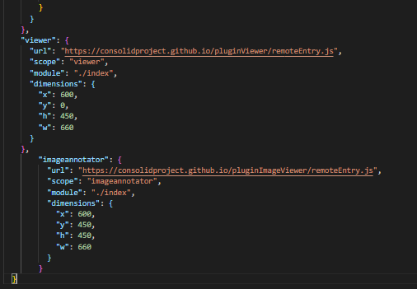
E.g. For task X, I will need:
- a 3D viewer that can display IFC models
- an image annotator
- a SPARQL query module
- …
https://lbd-dev.org/resourceOverview/remoteEntry.js
https://3dsolutions.be/viewerplugin/remoteEntry.js
https://lbd-dev.org/resourceOverview/remoteEntry.js
https://another.comg/imgAnnotate/remoteEntry.js
END-USER INTERACTION

Slide 28
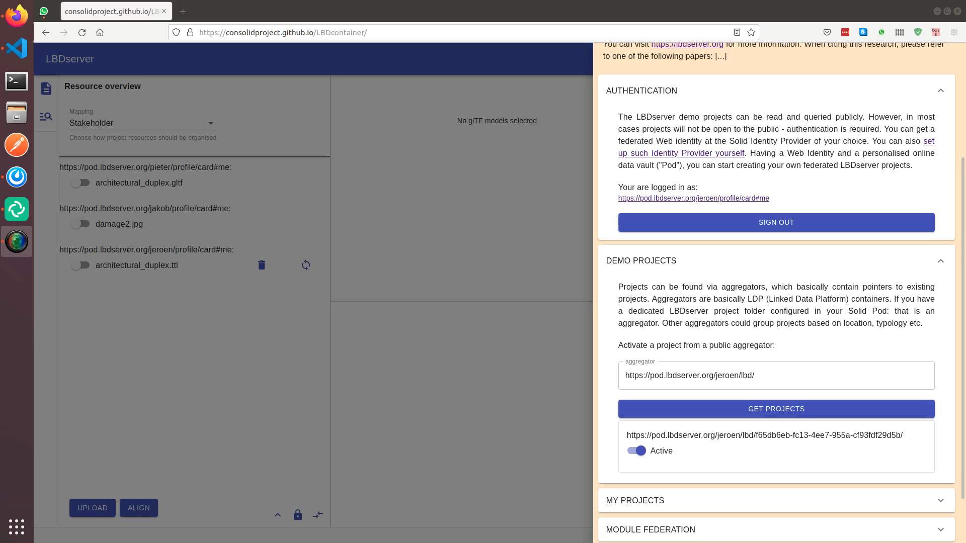

Slide 29
4. Proof-of-concept

Slide 30
Try it out
Very experimental!
http://demo.lbdserver.org

Slide 31
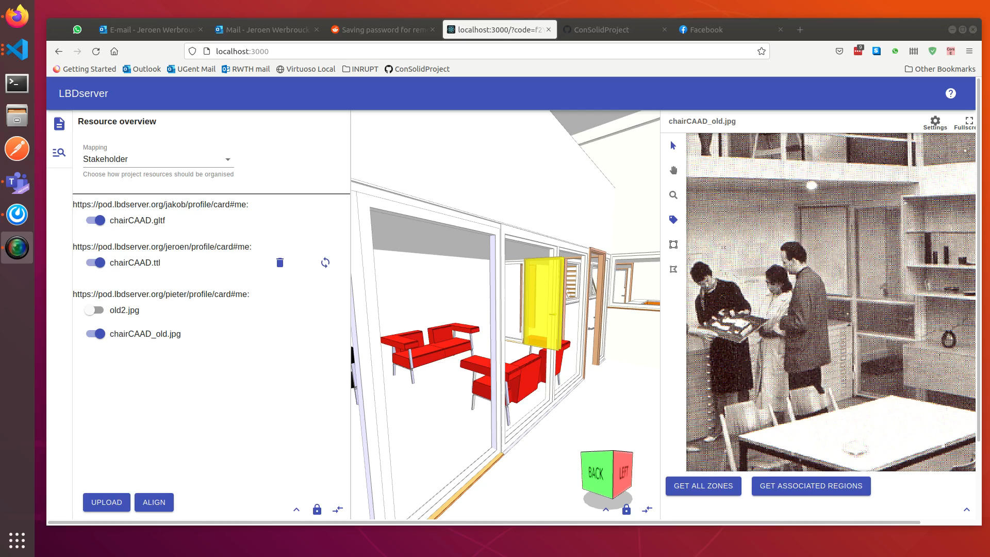
Implementation: demo I

Slide 32
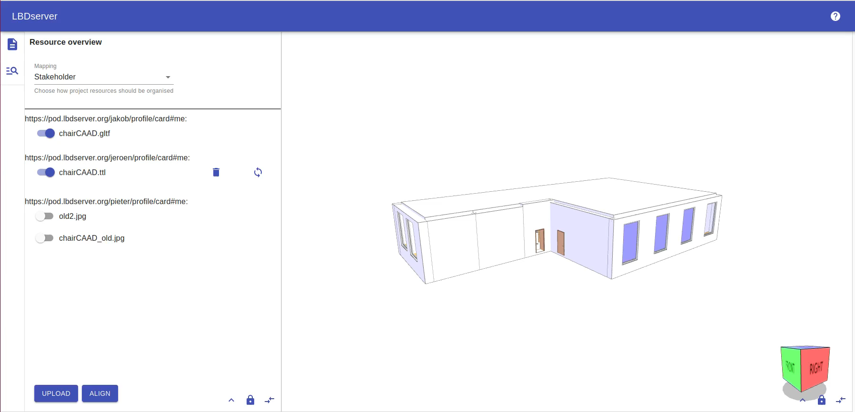
Implementation: demo II

Slide 33
5. conclusion

Slide 34























Technological overview of the LBDserver
DATA FEDERATION
WAC
WebID
LDP
APPLICATION
AECO-STORE
DATA FEDERATION
module federation
SERVICE
FEDERATION
W3C STANDARDS
FRONT-END
FEDERATION
OPEN API
{REST}
GraphQL
DATA INTEGRATION
ICDD
DATA FEDERATION
LBD
BCF
Notes:
How to securely store access-restricted data?
How to connect heterogeneous data in a flexible way?
How to interact with this diversity?
How to connect project-specific and contextual (open) data?

Slide 35
Code base
All code is very experimental!
http://demo.lbdserver.org
https://github.com/ConsolidProject/
Backend server: API + (CSS + MongoDB + Fuseki)
µFrontEnd plugins (React)
Example
Template
API (npm i consolid)

Slide 36
Summary
“Federated multi-model” based on Solid (AUTH) and well-established data storage technologies
Abstract “things” have file-specific representations
Disparate UI modules can communicate with one another using abstract things & filtered manifestations
UI modules of different origin can be configured in a “shopping cart” configuration

Slide 37
Future work
External dataset integration
Stress test & optimisation
Network orchestration & automatisation (“POD satellites”)
Communication & data streams
Data sanitation
Data discovery
Checking & validation
Documentation (LBDserver plugins, npm API, …) “Get started as an LBDserver developer”

Slide 38





Contact
Main Research
Jeroen Werbrouck
PhD Researcher (FWO Flanders)
Ghent University | RWTH Aachen
jeroen.werbrouck@ugent.be
Promotors
Erik Mannens (Ghent University | IMEC )
Pieter Pauwels (Ghent University | TU Eindhoven)
Jakob Beetz (RWTH Aachen)
Project Info
https://lbdserver.org
https://github.com/ConSolidProject/

Slide 39
THANK YOU!

Slide 40
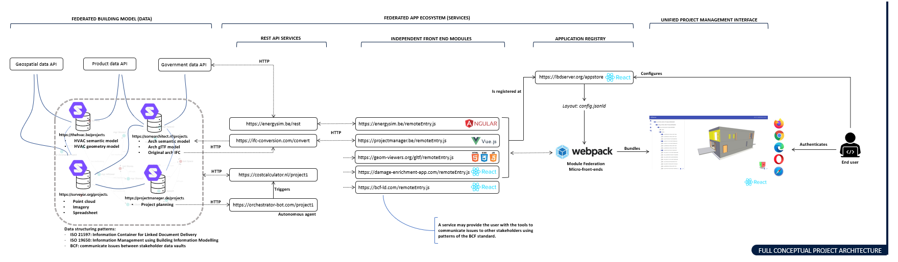
Appendix

Slide 41
Background concepts: UI
Plugins can run standalone & in configuration
Plugins have a dedicated topic (e.g. visualisation, query, checking …)
Configurations
loaded on runtime
straightforward developer experience (separate repo & deploy)
can be mapped to address use cases (“shopping cart”)
Container “distributes” concepts to enable communication
auth
project
active resources
Selection

Slide 42
Demo: config loading

Slide 43
reference Registry: local
hasLinkElement
arch: art1
own:art8
lbd:hasReference
hasDocument
le1
hasIdentifier
Lbd:inDataset
hasIdentifier
le3
arch.ttl
id1
fm:art5
identifier
model.gltf
id3
</arch.ttl#door1>
identifier
arch:artefactRegistry.ttl
“Brep 1”
own:artefactRegistry.ttl
hasLinkElement
hasDocument
le2
hasIdentifier
damage.ttl
id2
identifier
</damage.ttl#element1>
fm:artefactRegistry.ttl
@prefix arch: <https://archoffice.de/lbd/abc123/> .
@prefix fm: <https://fm-bureau.fr/lbd/abc123/> .
@prefix own: <https://pod.inrupt.net/lbd/abc123/> .

Slide 44
reference Registry: global alignment
hasLinkElement
arch: art1
own:art8
lbd:hasReference
hasDocument
owl:sameAs
le1
hasIdentifier
Lbd:inDataset
hasIdentifier
le3
arch.ttl
id1
fm:art5
identifier
model.gltf
id3
</arch.ttl#door1>
identifier
arch:artefactRegistry.ttl
“Brep 1”
own:artefactRegistry.ttl
hasLinkElement
hasDocument
le2
hasIdentifier
damage.ttl
id2
identifier
</damage.ttl#element1>
fm:artefactRegistry.ttl
@prefix arch: <https://archoffice.de/lbd/abc123/> .
@prefix fm: <https://fm-bureau.fr/lbd/abc123/> .
@prefix own: <https://pod.inrupt.net/lbd/abc123/> .

Slide 45
Conceptual overview of the lbdserver

